Slide 1

Internship Program
Analysis
(Helen Zhao 02/08/2026）

Slide 2
This presentation covers:
Key findings and data trends, including supporting visuals and assumptions.
Root cause analysis for underperformers in the internship program.
Recommendations and next steps.

Slide 3
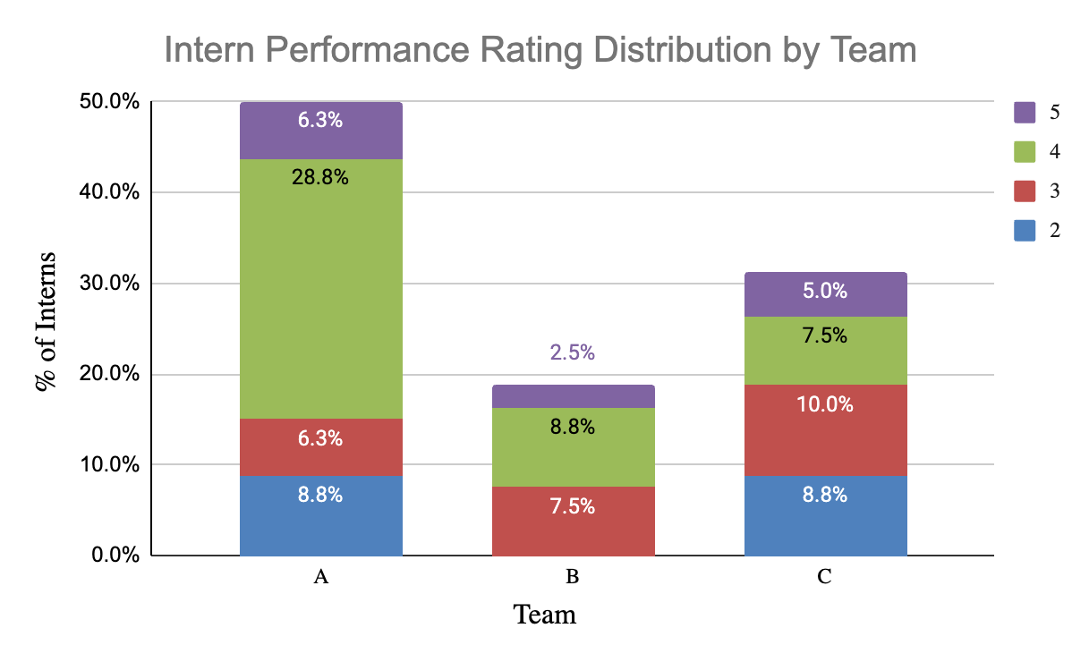
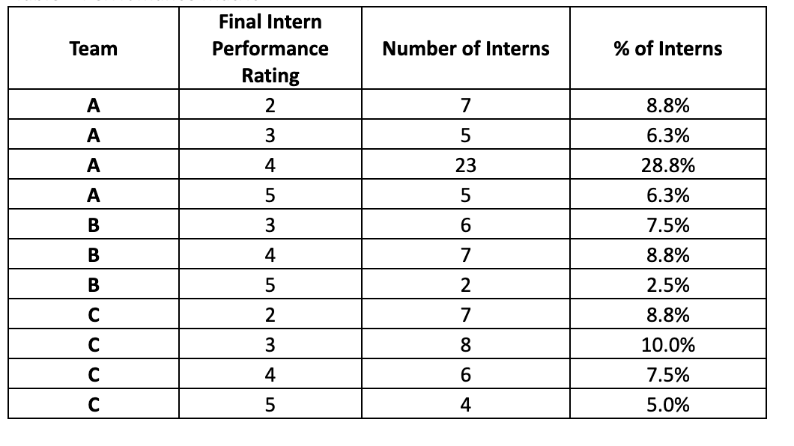
Distribution of Intern Performance Across Teams
The internship program encompasses 80 participants, who were allocated across three teams.
The data reveals the following:
Team A holds the largest proportion of interns, representing 50% of the total, followed by Team C with approximately 31% and Team B with about 19%.
Final Performance Rating 4 is the most frequent outcome, constituting 45% of all evaluations, significantly surpassing Rating 5 (13.8%).
Team A contributes the greatest share of top performers, accounting for nearly half of all Rating 5 results, whereas Team B contributes the smallest portion.

Slide 4
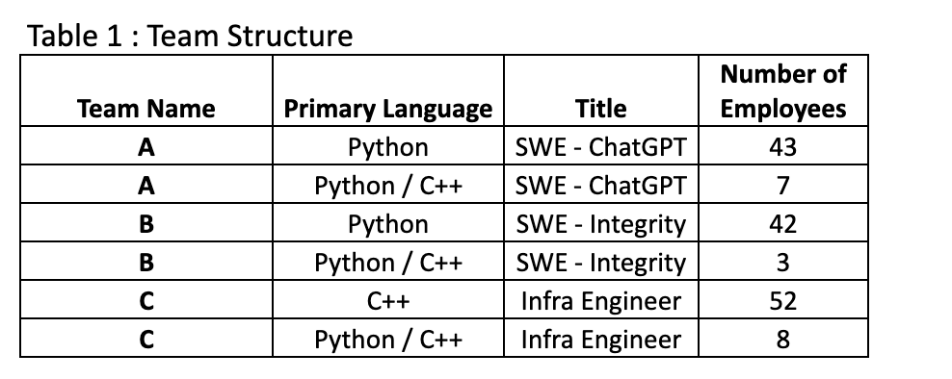
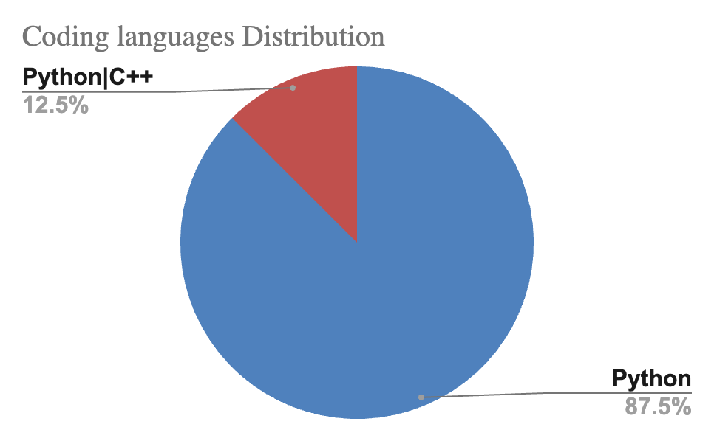
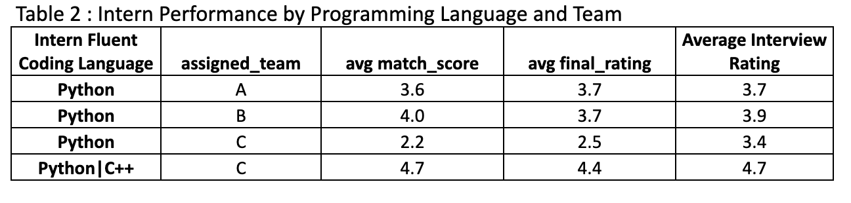
Team Structure
Intern Performance
Team A and Team B are Python-dominant and focus on software development.
Team C is structurally different, C++ focused, and primarily handles infrastructure.
Multi-language interns are assigned to Team C.
Interns are mostly fluent in Python.
In Team C,
  Interns with Python and C++ coding languages have the highest overall interview scores, team match scores, and final performance ratings.
  Interns without C++ experience have the lowest overall performance rating, interview score, and team match score on average.

Slide 5
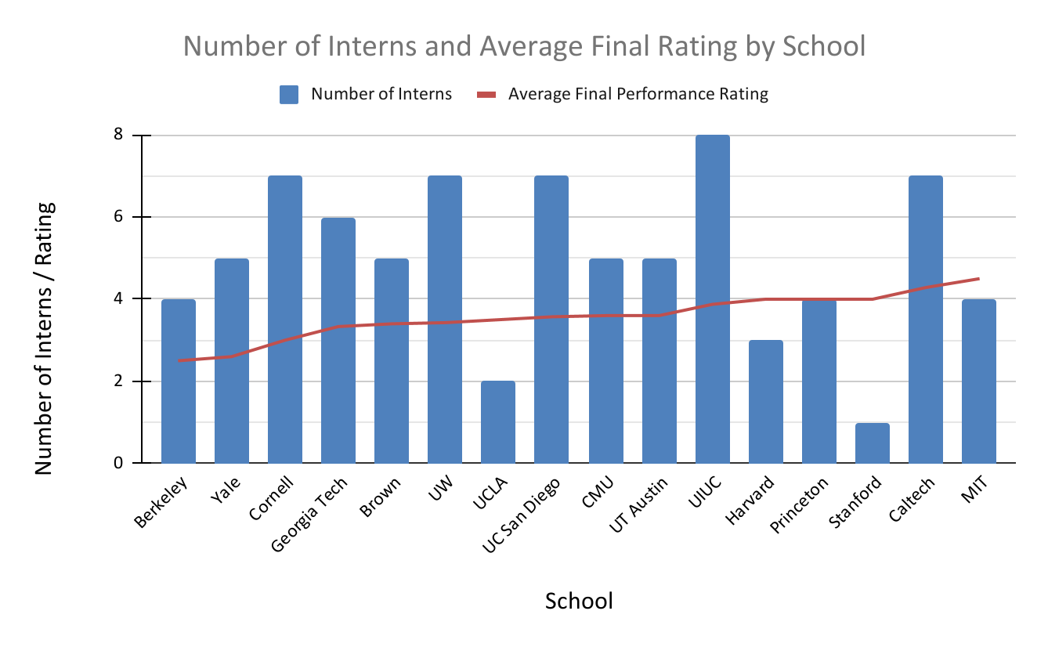
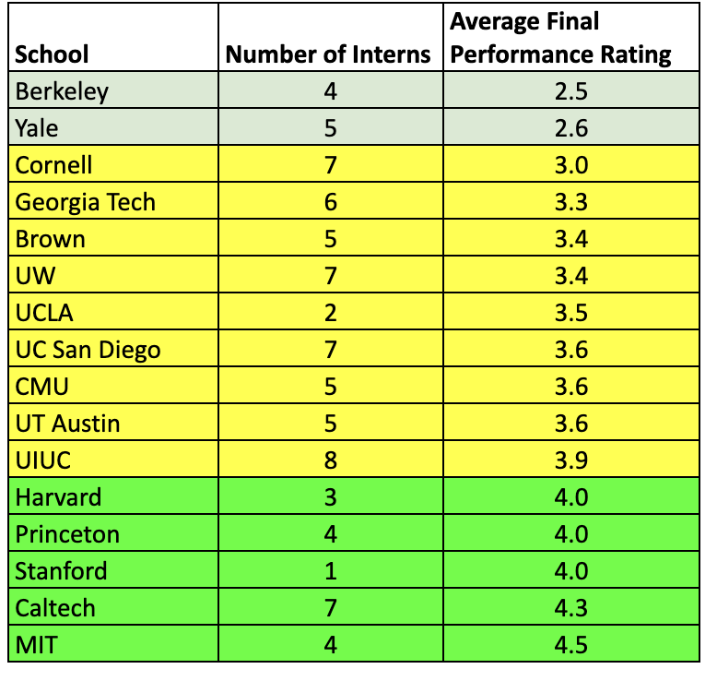
Where Our Best Intern Talent Comes From
Our interns were sourced from 16 different universities.
The data reveals the following:
Top performance (average rating greater than 4) is observed among interns from Harvard, Princeton, Stanford, Caltech, and MIT. These institutions show the highest performance, despite having relatively small intern counts.
Overall, UIUC demonstrates the best balance, having the largest intern population while maintaining solid performance.
Only few institutions manage to successfully balance both quality and scale.

Slide 6
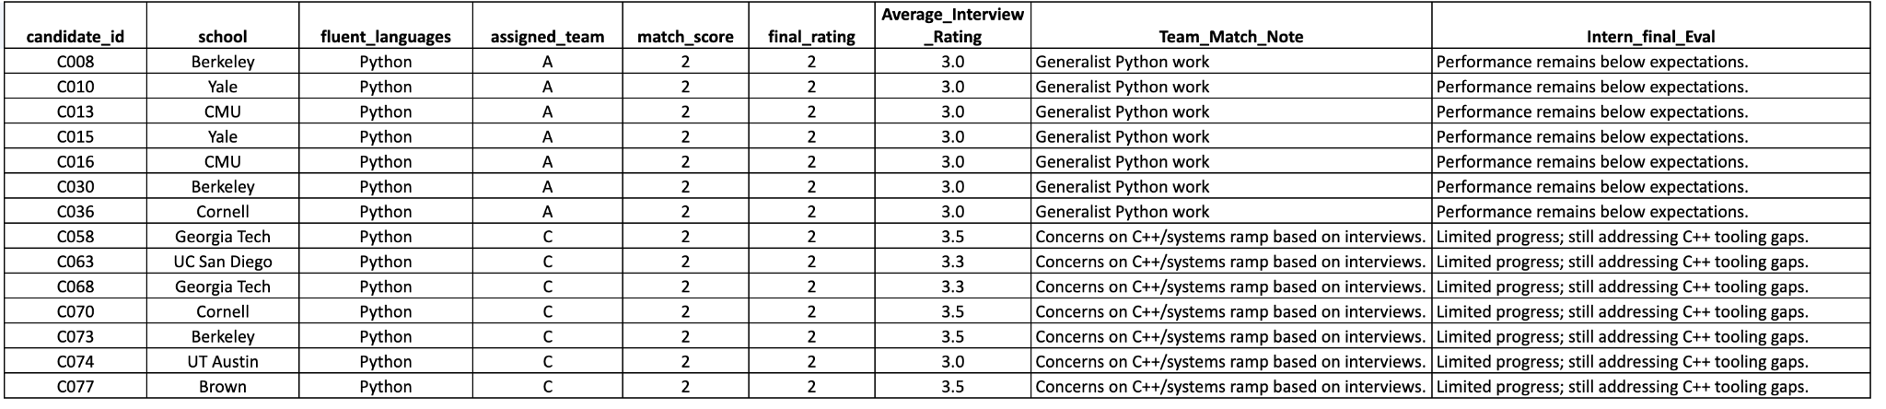
Systemic Skill–Team Mismatch in Python-Only Interns
These interns were from Team A and Team C. 14 interns received a low performance rating (final performance rating = 2).
They are all Python-Only interns.
They had a low team match score and an overall moderate to low post-interview rating.
The interns from Team C specifically lacked C++ coding experience, indicating a misalignment with infrastructure needs.
Despite some receiving interview ratings over 3.0, the final rating remained 2, suggesting interview performance may have overestimated on-the-job success.

Slide 7
Recommendations and Next Steps:
Enhance skill alignment : Avoid placing interns with Python-only programming skills on teams that primarily use non-Python languages or have high C++ requirements. If assigned to a C++ team, provide a one-week C++ or relevant coding training to facilitate their integration.
Establish core technical prerequisites: Require exposure to Python and C++ or equivalent systems-level programming as a baseline for assignment to highly complex teams.
Consider increasing the intern headcount from schools that consistently demonstrate a top average performance (> 4.0).
Implement a stricter role-based screening process, hiring interns based on the potential team's needs and required skills, and adding role-specific assessments to the interview process.
Introduce role-specific intern tracks to prevent misalignment between intern skill sets and team needs, reducing the risk of underperformance.
Evaluate intern performance using metrics that extend beyond the singular final performance rating.

Slide 8
Thank you!

